Slide 1
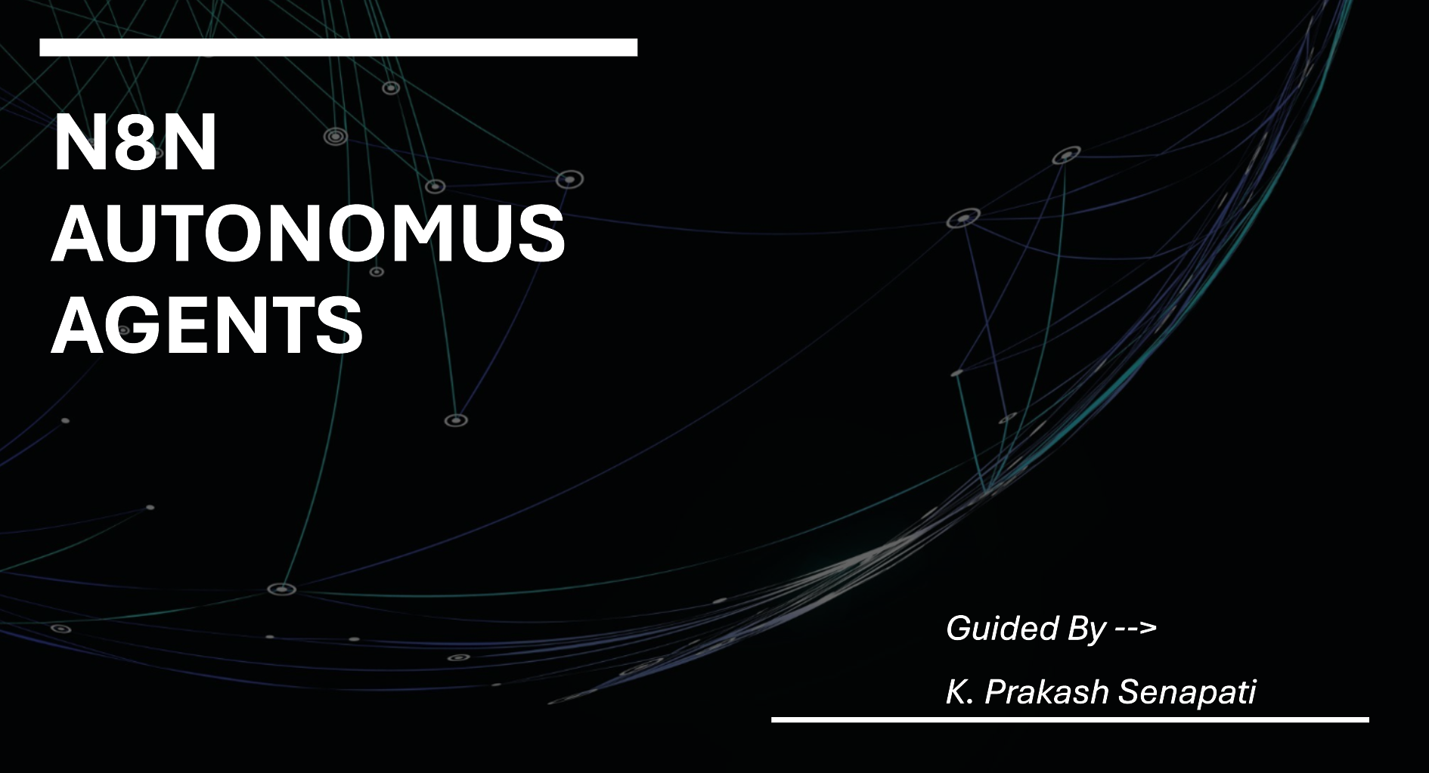
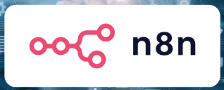

Slide 2
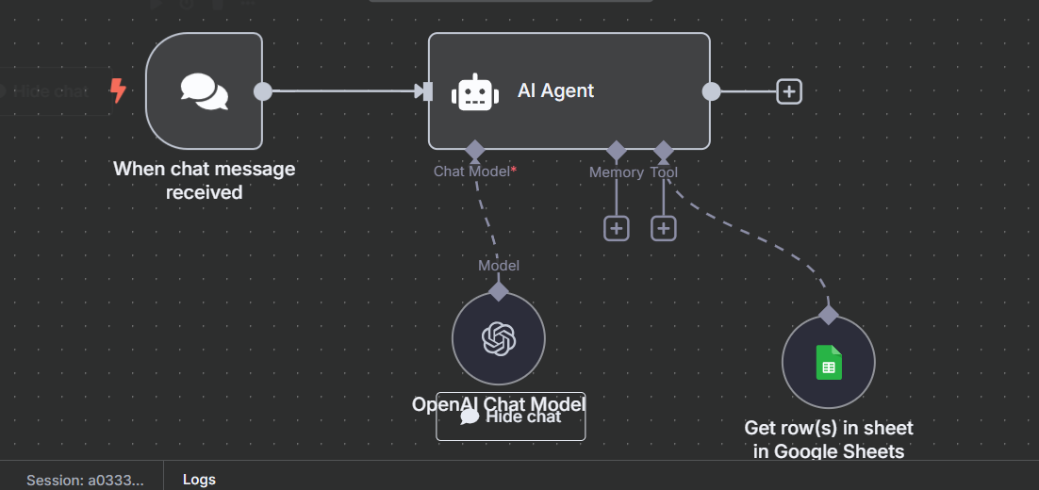

AGENTIC AI ( N8N AGENTS)

Slide 3
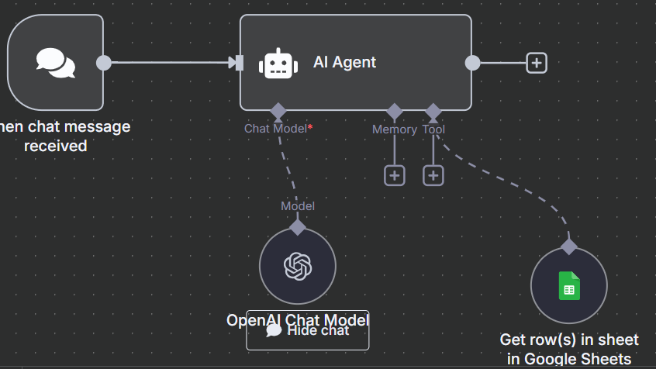
What is n8n?
n8n (Node for Node) is a powerful workflow automation tool that allows you to connect different apps and services together—without writing any code.

Slide 4
AUDIENCE ATTEND THIS WORKSHOP
Whether you’re a student, freelancer, business owner, or developer, n8n helps automate repetitive tasks, saving you time and effort.

Slide 5
Key Features of n8n:
🔗Connect 300+ Apps: n8n supports integrations with popular apps like Google Sheets, Gmail, Notion, Slack, Telegram, Discord, WhatsApp, Airtable, and more.
🧩No-Code Visual Builder: You can easily create workflows using a drag-and-drop interface. Just connect blocks (nodes) to define how data flows.
⚙️Custom Code When Needed: If you're technical, you can add JavaScript functions for advanced customization.
🔁Smart Logic: Supports conditions, loops, branches, and error handling to build intelligent automations.
🌍Self-Host or Cloud: You can use the hosted version at n8n.cloud or install it on your own server using Docker.
💸Free and Open Source: n8n is completely open source, giving you freedom, flexibility, and zero licensing fees.

Slide 6
Why Use n8n?
✅ Eliminate manual work
✅ Save hours every week
✅ Improve accuracy and consistency
✅ Build automation skills without coding
✅ Great alternative to Zapier (more powerful, free to host)

Slide 7
What Can You Build With n8n?
Here are a few real-world automation examples:
1. Social Media Automation
Auto-post to Twitter when you upload a YouTube video.
2. Email Alerts
Send an email alert when a form is submitted or a Google Sheet is updated.
3. WhatsApp/Telegram Bot
Send order updates, reminders, or welcome messages automatically via WhatsApp or Telegram.
4. Lead Management
When someone fills a Google Form, store their info in Notion and alert the sales team.
5. Daily Report Generator
Fetch data from APIs (e.g., weather, sales), format it, and send it to your inbox every morning.

Slide 8
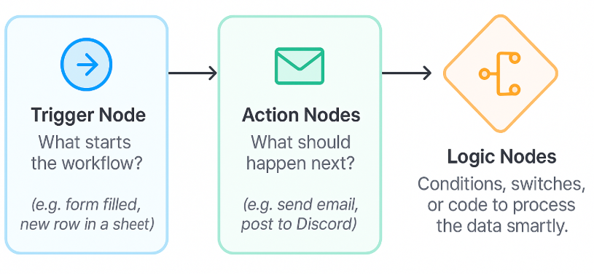
Components of an n8n Workflow
Trigger Node: What starts the workflow? (e.g., form filled, new row in a sheet)
Action Nodes: What should happen next? (e.g., send email, post to Discord)
Logic Nodes: Conditions, switches, or code to process the data smartly.

Slide 9
🎓 Who Should Learn n8n?
Non-tech students who want to automate basic digital tasks
Small business owners who manage social media, leads, or reports
Developers who want a fast way to build integrations
Anyone looking to enter no-code automation careers

Slide 10

Agentic AI Framework Components
Component --> Description
Agent--> Autonomous system that can perceive, decide, and act to achieve a goal.
Environment --> The context in which the agent operates (web, APIs, user interfaces, etc).
Perception --> How the agent gathers information (APIs, sensors, user input, etc).
Memory --> Stores short-term (contextual) and long-term (factual/task) data.
Planning --> The agent's ability to break goals into tasks or steps (task decomposition).
Decision Engine --> Uses rules, logic, or LLMs to determine next best action.
Tool Use --> Invokes external tools like web search, APIs, databases, calculators.
Learning --> Adapts from past results (feedback loops, reinforcement, fine-tuning).
Goal Alignment --> Ensures actions are relevant to the user-defined goal or prompt.

Slide 11
TOP AGENTIC FRAMEWORK 2025
Framework | Description | Key Features | Language
LangGraph | Event-driven multi-agent framework built on top of LangChain | Directed cyclic graphs, agent memory, retries, tool use | Python
CrewAI | Multi-agent collaboration with role-based agents | Role, goal, task assignment, memory, hierarchical agents | Python
Autogen (Microsoft) | Conversational agent framework for multi-agent systems | Group chats, human-AI feedback, agent roles, tools | Python
OpenAgents (OpenAI) | Prototype agent system for task delegation using GPTs | Tool usage, search, file browsing, calendar integration | Python (early access only)
Smol-AI / Smol Developer | Lightweight AI agents that build software | Task breakdown, planning, codegen agents | Python
MetaGPT | Multi-role collaborative agents for software development | PM, Engineer, QA roles; Git-style workflows | Python
AutoGPT | Open-source autonomous agent powered by GPT + memory | Long-term memory, web search, tool use | Python
BabyAGI | Minimal agent with task planning and prioritization | Todo-list manager, feedback loop | Python
SuperAGI | Production-grade agent framework with GUI and marketplace | Web UI, memory, agent templates, docker support | Python
AgentVerse | Simulation platform for multi-agent environments | Environment-based agent interaction | Python
Camel-AI | Agent-to-agent dialog system (e.g., coder talking to planner) | Roleplay-based task-solving agents | Python

Slide 12
Common Features of Agentic Frameworks
Memory: Short-term (contextual) and long-term (vector DB or local)
Planning: Automatic task decomposition
Tool Integration: Plugins, APIs, Browsers, Code Execution
Coordination: Multi-agent collaboration
Autonomy Control: Human-in-the-loop or fully autonomous
Environment Interaction: Files, Web, Terminal, APIs, etc.

Slide 13
Use case of Agents
Code generation and review
Research assistants
Workflow automation
DevOps and scripting
Personal AI assistants
Knowledge retrieval (RAG + planning)

Slide 14
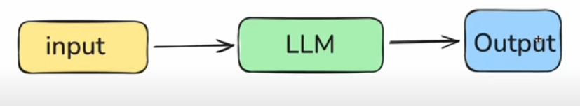
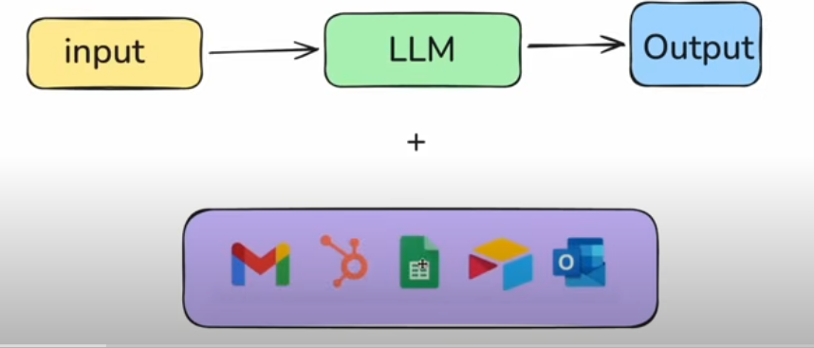

Slide 15
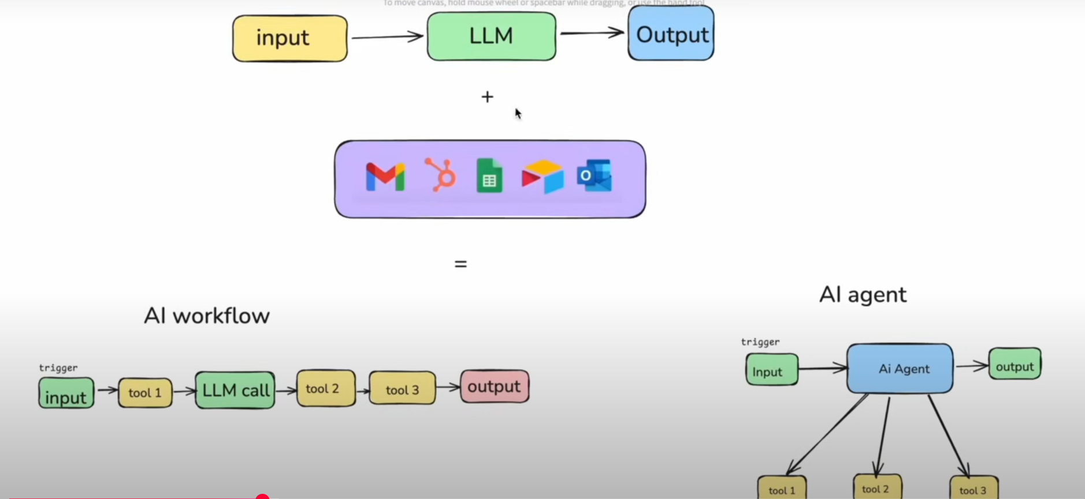

Slide 16
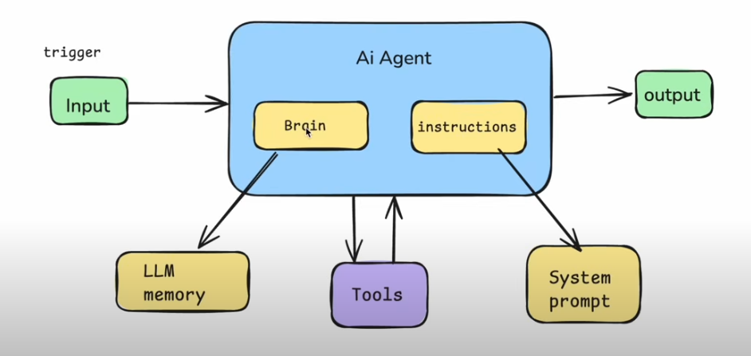

Slide 17
Q & A

